Slide 1
Client-Server Computing in Mobile Environments
Presenter : Rohan A. Bairat

Slide 2
Client-Server Architecture
Versatile, Message based, Modular Infrastructure intended to improve usability, flexibility, interoperability and scalability as compared to Centralized, Mainframe, time sharing computing.
Intended to reduce Network Traffic.
Communication is using RPC or SQL

Slide 3
Mobile Computing and Issues in Client-Server Environment
Mobile Computing a new Paradigm
Issues
  Mobility of Users and their computers
  Mobile Resource constraints
    Wireless Bandwidth
    Limited Battery Life

Slide 4
Paradigms of Mobile Client-Server Computing
Mobile Aware Adaptation
  Response to change in environment
  Necessary system services that can be utilized
Extended Client-Server Model
  Various Architectures that enables functional participation of applications between client and servers
Mobile data Access
  Deals with issues like data transfer and consistency of Client cache

Slide 5
Mobile-Aware Adaptation
Dynamically adjusting the functionality between the mobile and stationary host to cater changes like
    Variations and changes in Network Conditions
    Local resource availability
Computations of Clients and Servers should be adaptive in response to change in mobile environment.

Slide 6
Mobile-Aware Adaptation
Application Transparent Adaptation
  Applications work with no modification in mobile environment
  System shield or proxy is provided which hides the differences between the stationary and mobile environments from Applications
  The proxy / System shield mitigates to the change in environment and the change is transparent to the applications.

Slide 7
Application Transparent Adaptation
E.G. File System Proxy (CODA)
  File System Proxy hides mobile issues from applications and emulate file server services on the mobile device.
  Proxy Log
  Concurrency control after reconnection
Three phases
    Hoarding
      Server Files pre-fetched into Mobile Computers
    Emulating
      Upon Disconnection updates are logged
      Log optimization is done to improve performance
    Reintegrating
      Synchronizes cache with the server

Slide 8
Application Transparent Adaptation
Drawbacks of this approach
  Performance is an issue
  It may be sometimes very hard for the system Some manual user intervention may be needed

Slide 9
Application-Aware Adaptation
Allows Applications or their extensions to react to mobile resource changes
How?
  Collaboration between System and individual Applications
  System monitors resource levels and notifies applications of relevant changes
  Application then adapts to the change

Slide 10
Application-Aware Adaptation
It can be divided into three different categories
  Client- based Application adaptation
  Client-server Application adaptation
  Proxy-based Application adaptation

Slide 11
Client- based Application Adaptation
In the Collaborative adaptation ,System provides mechanisms of adaptation, while applications are free to specify adaptation policy
Application changes or adaptation is done only on client side

Slide 12
Client-Server Application Adaptation
The Rover toolkit supports the application aware adaptation through the use of RDO http://www.pdos.lcs.mit.edu/rover/
RDOs are relocatable dynamic objects
RDOs are defined for the data types manipulated by the application and for the data transported between client and server
Programmers Task
Benefits to Application Designers
  Application designers have semantic knowledge
  Can tightly couple data with program code and manage resources

Slide 13
Proxy-Based Application Adaptation
The application specific proxy has been proposed as an intermediary between client and server
It performs storage intensive and computation intensive tasks
Proxy reduces Bandwidth demands and allow legacy and non standard client to communicate with the server

Slide 14
Extended Client-Server Model
Classic client-server systems assume that the location of client and server hosts do not change and also the connection among them does not change
Functionality between client and server is statically partitioned
Extended Client server Architecture thus deals with these inconsistencies in network connections and location specifics

Slide 15
Extended Client-Server Model
Thin client architecture
Full client architecture
Flexible client architecture

Slide 16
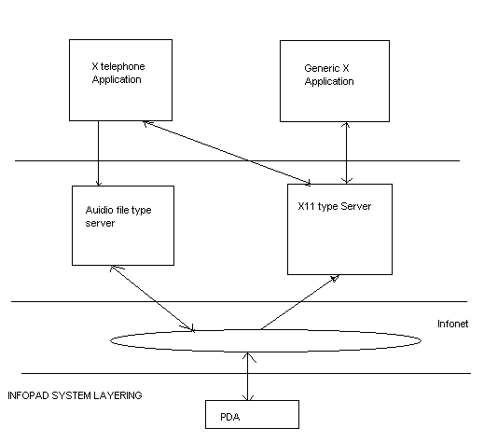
Thin client architecture

Slide 17
Full-Client Architecture
Can support disconnected or weakly connected client
The full client architecture supports emulations of functions of server at client host
Light weight servers or proxy
E.G CODA , WebExpress

Slide 18
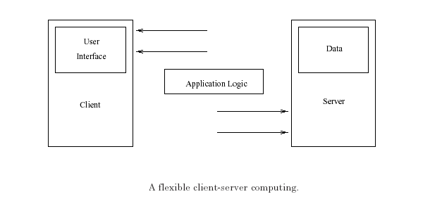
Flexible Client-Server Architecture
Generalizes both thin client and full client architecture
Connection between client and server can be dynamically established

Slide 19
Mobile Objects
Programming entities that can freely roam the network
Mobile objects allow clients to download the server code to mobile host for execution
They can maintain state information and make intelligent decisions
Challenge in using mobile objects?
  Frequently disconnected or weak environment

Slide 20
Collaborative Groups
Division of members into groups
Members can access data for the group
A client is able to access data residing on server to which it is communicating and conversely any machine holding the copy of the database, including personal laptop, should be willing to server read and write requests from nearby machines
E.G Bayou system

Slide 21
Flexible Client-Server Architecture
Application specific proxy
  Proxy acts an intermediary between clients and server
  Allows legacy and other non-standard clients to interoperate with existing servers
Virtual mobility of servers
  Achieved by replication

Slide 22
Mobile Data Access
Mobile data access enables the delivery of server data and the maintenance of client-server data
Data Access strategies in mobile environment can be characterized by
  Data delivery
  Data organization
  Consistency requirement
Server Data Delivery Modes
  Client –pull
  Server-push
  Hybrid delivery

Slide 23
Server Data Dissemination
Asymmetrical communication between clients and server
Scalability problems for applications with asymmetrical communication
Solution: Broadcast –based dissemination
Broadcast disk
Indexing on air
  Increases query time
  Decreases Listening time

Slide 24
Client Cache Management
Caching reduces contention and improves query response time
Cache data can support disconnected operations
Automated Hoarding
Varied Granularity of Cache coherence
  Callback Approach
  Detection Approach

Slide 25
Thank you
Rohan A. Bairat

